Slide 1
Finding MHD Equilibrium

Slide 2

Equilibrium equation
$$∇p=j×B$$
$$j=\frac{∇×B}{μ_{0}}$$
$$∇∙B=0$$

Slide 3
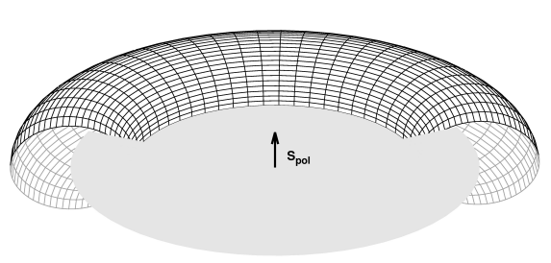
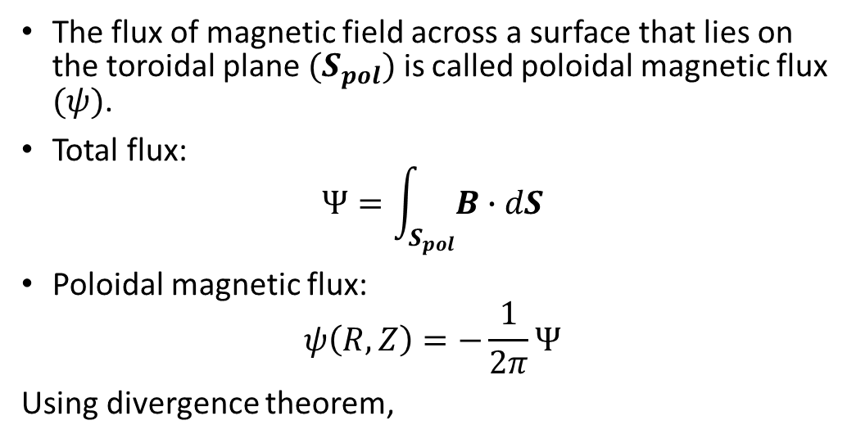
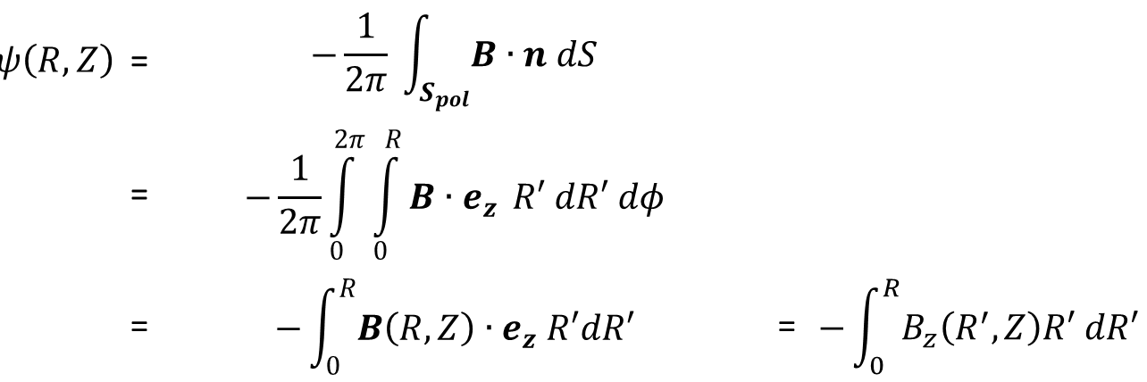
Magnetic Flux
The flux of magnetic field across a surface that lies on the toroidal plane $(S_{pol})$ is called poloidal magnetic flux $(ψ)$.
Total flux:
$$Ψ=\int_{S_{pol}}^{ }{B∙dS}$$
Poloidal magnetic flux:
$$ψ\left(R,Z\right)=−\frac{1}{2π}Ψ$$
Using divergence theorem,
$$ψ\left(R,Z\right)$$ | = | $$−\frac{1}{2π} \int_{S_{pol}}^{ }{B∙n dS}$$
 | = | $$−\frac{1}{2π}\int_{0}^{2π}{\int_{0}^{R}{B∙e_{z}} R′ dR′ dφ}$$
 | = | $$−\int_{0}^{R}{B\left(R,Z\right)}∙e_{z} R′dR′$$ | = | $$−\int_{0}^{R}{B_{z}\left(R^{′},Z\right)R′ dR′}$$

Slide 4
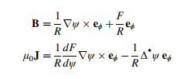

Grad-shafranov equation
$$μ_{0}R^{2}\frac{dp}{dψ}+F\frac{dF}{dψ}+Δ^{∗}ψ=0$$
With
$$Δ^{∗}ψ=R^{2}∇∙\left(\frac{∇ψ}{R^{2}}\right)=R^{2}∂_{R}\left(\frac{1}{R^{2}}∂_{R}ψ\right)+∂_{φ}^{2}ψ+∂_{z}^{2}ψ$$

Slide 5
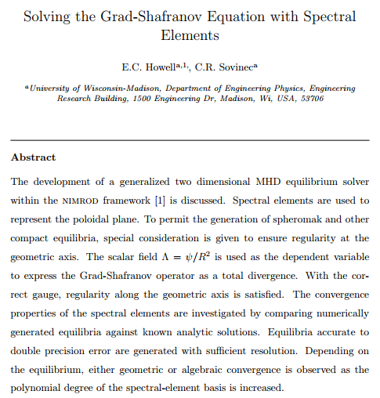
Howell et al (2014)

Slide 6
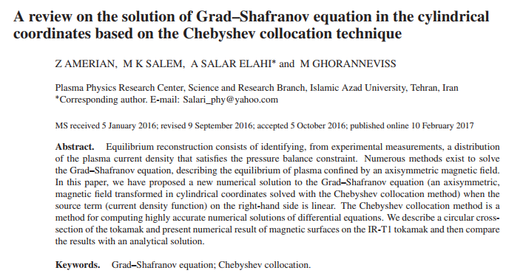
Amerian et al (2016)

Slide 7
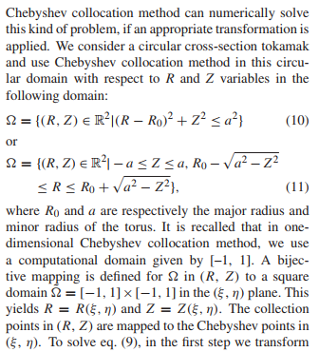
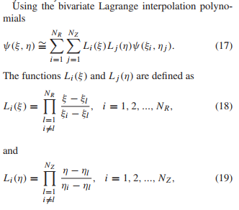
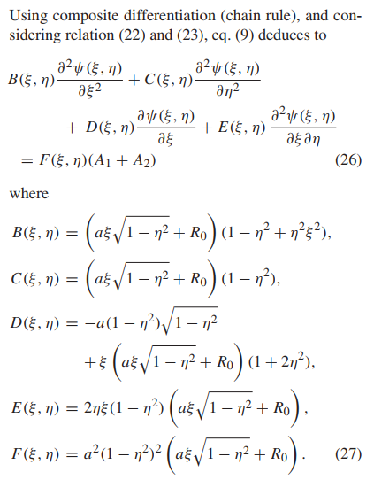
Amerian et al (2016)

Slide 8
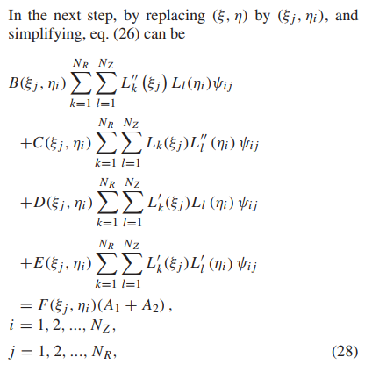
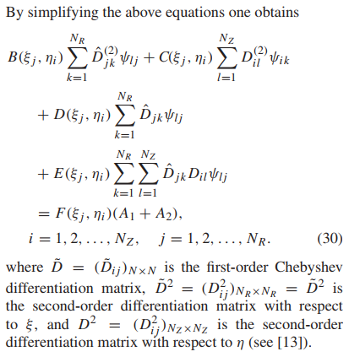
Amerian et al (2016)

Slide 9
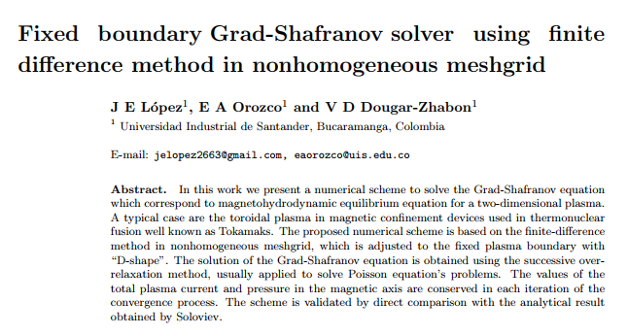
Lopez et al (2019)

Slide 10
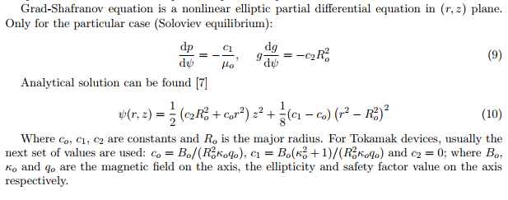
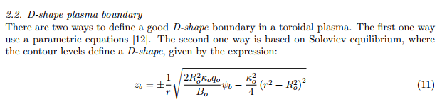
Lopez et al (2019)

Slide 11
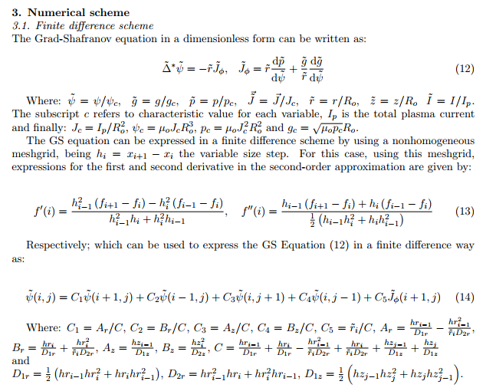
Lopez et al (2019)

Slide 12
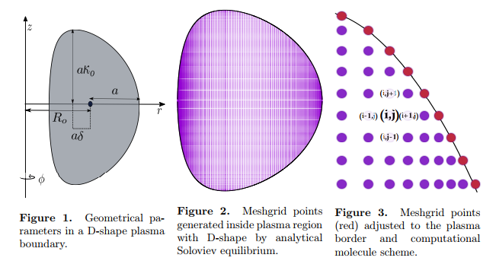
Lopez et al (2019)

Slide 13
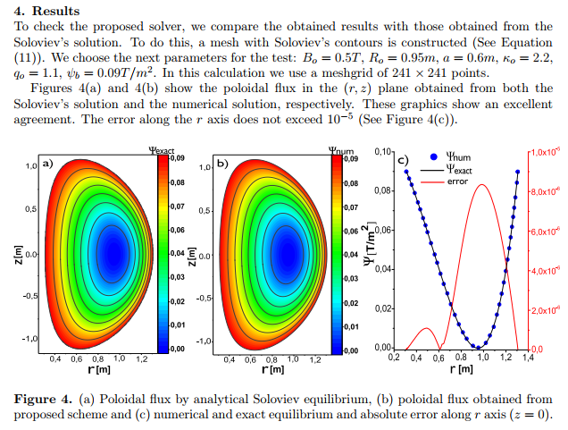
Lopez et al (2019)

Slide 14
Lattice Boltzmann
Lattice Boltzmann Method is a dynamic method that simulates the macroscopic behavior of fluids by using a simple mesoscopic model. It inherited the main principles of Lattice Gas Automaton (LGA) and made improvements. From lattice gas automaton, it is possible to derive the macroscopic Navier-Stokes equations.

Slide 15
Lattice Boltzmann Method
The lattice Boltzmann methods (LBM), originated from the lattice gas automata (LGA) method, is a class of computational fluid dynamics (CFD) methods for fluid simulation.
Instead of solving the Navier–Stokes equations directly, a fluid density on a lattice is simulated with streaming and collision (relaxation) processes.
The method is versatile as the model fluid can straightforwardly be made to mimic common fluid behaviour like vapour/liquid coexistence, and so fluid systems such as liquid droplets can be simulated. Also, fluids in complex environments such as porous media can be straightforwardly simulated, whereas with complex boundaries other CFD methods can be hard to work with.

Slide 16
Lattice Boltzmann Method
Unlike CFD methods that solve the conservation equations of macroscopic properties (i.e., mass, momentum, and energy) numerically, LBM models the fluid consisting of fictive particles, and such particles perform consecutive propagation and collision processes over a discrete lattice.

Slide 17
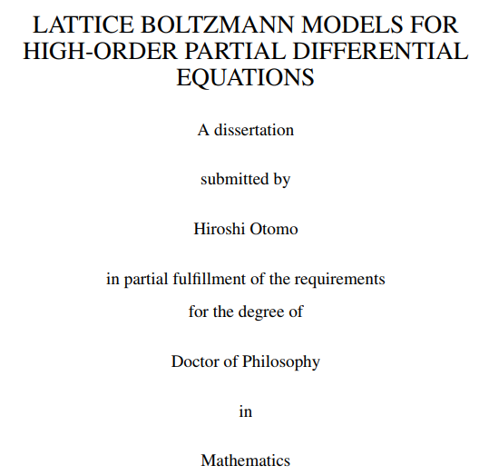
Lattice Boltzmann Method

Slide 18
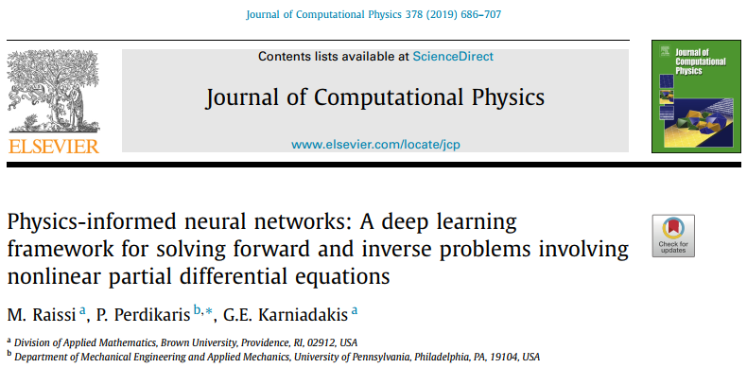
Raissi et al (2019): Physics-Informed Neural Networks

Slide 19
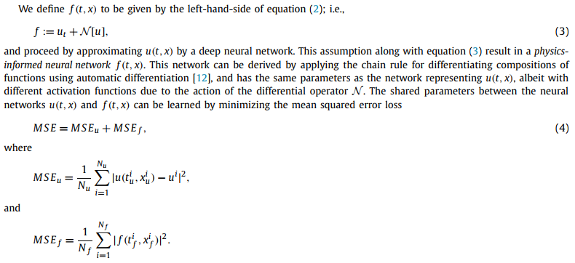
Data driven solutions

Slide 20
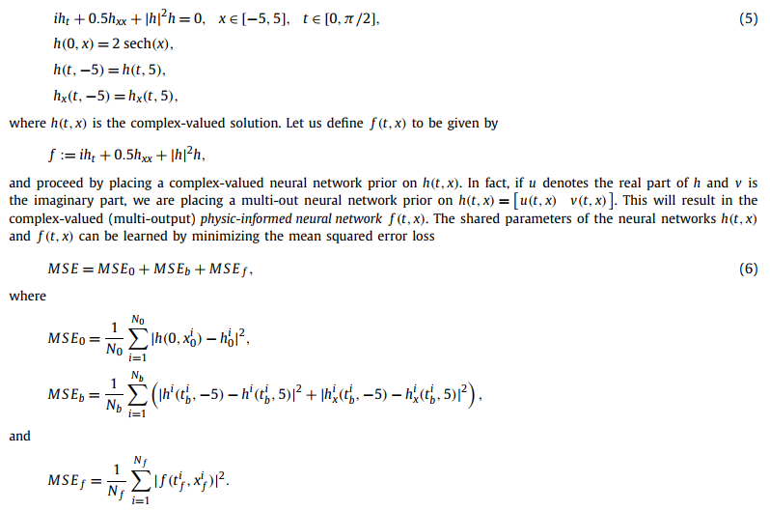
Example

Slide 21
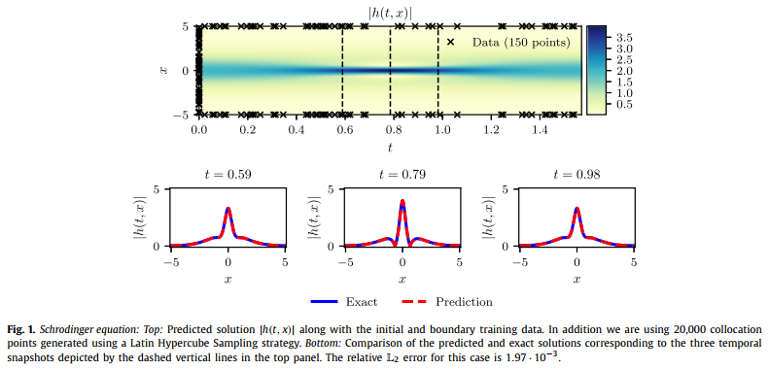
Result

Slide 22
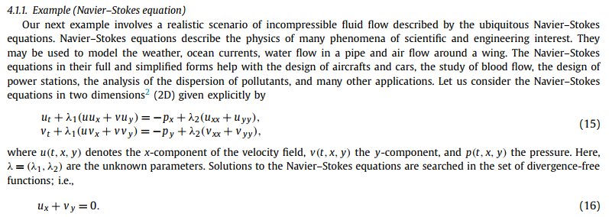
Data driven discovery

Slide 23
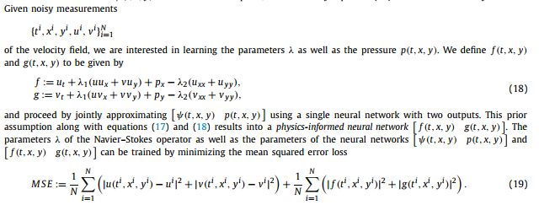
Data driven discovery

Slide 24
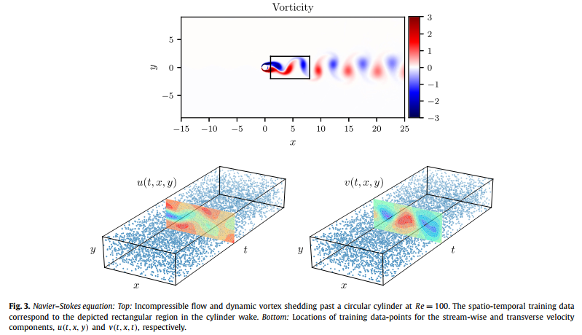
Solution

Slide 25
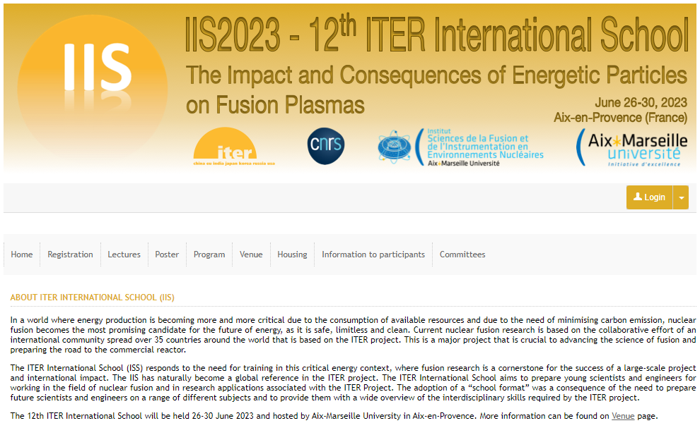
https://iis2023.sciencesconf.org/

